Slide 1
Introduction to Robotics
Dr. Divya Udayan J, Ph.D.(Konkuk University, S.Korea) Department of CSE Amrita School of Engineering, Amritapuri Campus, Amrita Vishwa Vidyapeetham Email: divyaudayanj@am.amrita.edu Mobile: 9550797705

Slide 2
Classification of Robots
Drive Technologies such as Electric, Pneumatic
and Hydraulic. Electric drives are generally DC Servomotors or DC Stepper motors.
2. Work-Envelope Geometries.
3. Motion Control Methods:
i. Point-to-point control and,
ii. Continuous path control.

Slide 3
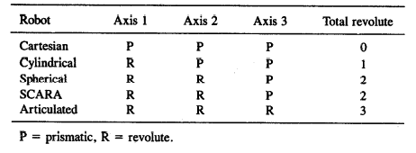
Work Envelope Geometries based on Major Axes

Slide 4
Refer Robot Configurations.pdf

Slide 5
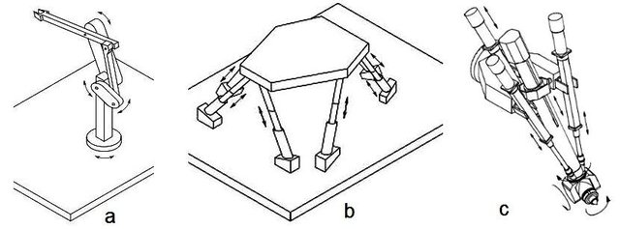
Parallel Robotic Manipulators
Closed Chain with
Parallelogram.
b. Parallel.
e.g., Stewart’s Platform.
c. Hybrid Parallel-Serial.

Slide 6
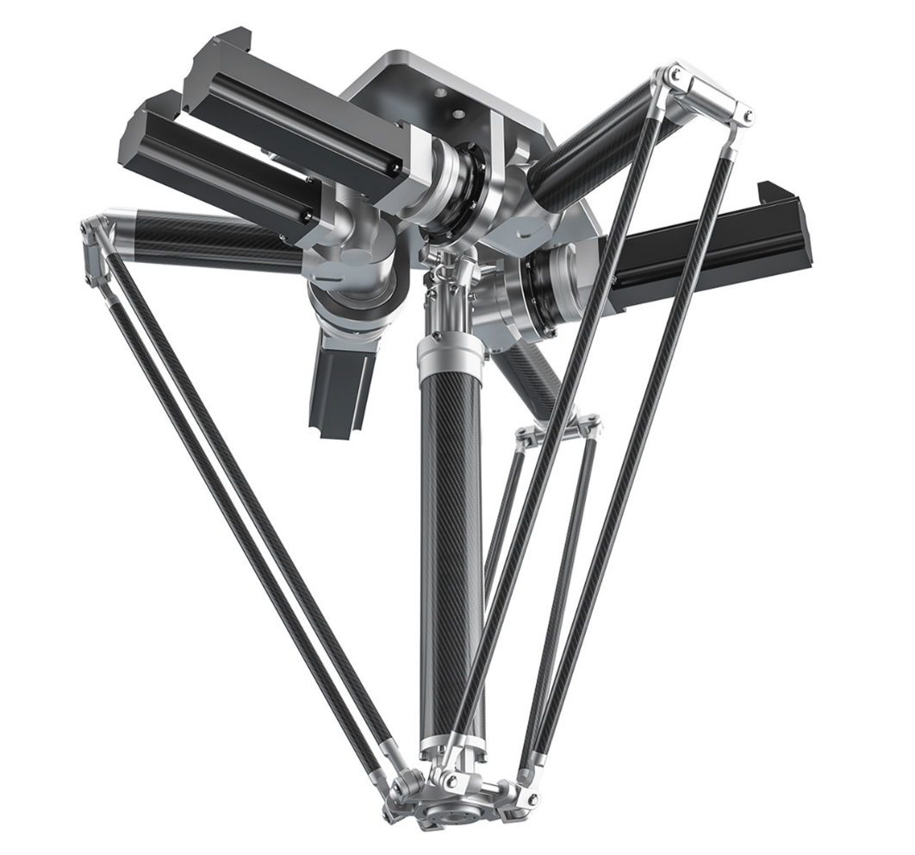
Delta Robot (Parallel Robot)
A delta robot is a type of parallel robot that consists of three arms connected to universal joints at the base. The key design feature is the use of parallelograms in the arms, which maintains the orientation of the end effector.

Slide 7
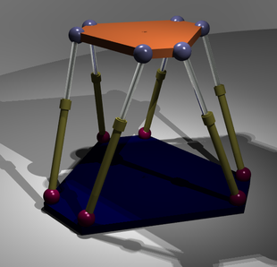
Gough-Stewart Platform (Hexapod Platform) Parallel Robot
Stewart platform can change the orientation of its end effector.

Slide 8
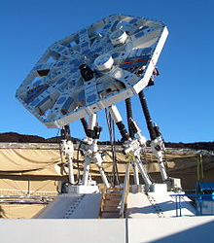
Gough-Stewart Platform (6 DoF Platform) Parallel Robot
Application: Flight Simulator
AMiBA Radio Telescope

Slide 9
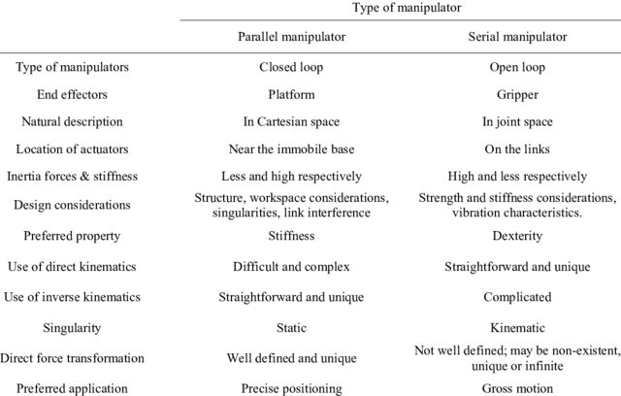
Comparison between Parallel and Serial Manipulators

Slide 10
Robot Specifications or Characteristics
Number of axes,
Load carrying capacity, kg,
Maximum speed, mm/s,
Reach and Stroke, mm,
Tool orientation, deg,
Repeatability, mm,
Precision and Accuracy, mm,
Operating environment.

Slide 11
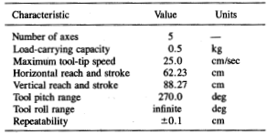
Rhino XR-3 Robot Specifications (contd.)

Slide 12
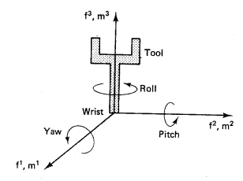
Tool Orientation (Yaw-Pitch-Roll or X-Y-Z system)

Slide 13
Repeatability, Precision and Accuracy
Repeatability is a measure of the ability of a robot
to position the tool tip in the same position
repeatedly.
Precision of a robot is the spatial resolution with
which the tool can be positioned within the work
envelope.
Accuracy of a robot is a measure of the ability of
the robot to place the tool tip at an arbitrarily
prescribed position in The work envelope.

Slide 14
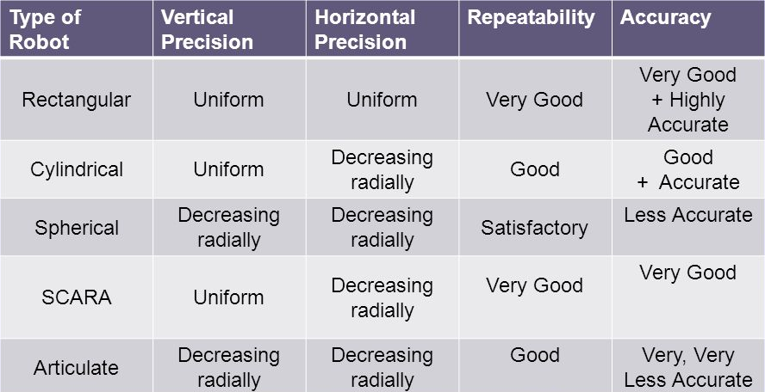
Repeatability, Precision and Accuracy (contd.)[just read]

Slide 15
Some robotic terms
Let’s get introduce with some important robotic terminologies:
Link → A rigid component of a robot, often attached to other links via joints.
Joint → An articulation point between two robot links.
Sensor → Sensors are devices that measure some physical quantities of the world and encode the signals into electrical (typically digital) form.
Actuator & Transmission → An actuator is a mechanism that generates a force/torque given electrical signals; a transmission is a mechanism that applies an actuator's forces/torques to the robot's links.
Payload → The ability to carry a given maximum weight at a given speed.
Velocity → The maximum speed at which the tip of a robot is capable of moving at full extension.
Cycle → Time it takes for the robot to complete one cycle of picking up a given object at a given height, moving it to a given distance, lowering it, releasing it, and returning to the starting point.
Repeatability → The ability of a robot to return consistently to a previously defined and achieved location.
Resolution → The smallest incremental change in position that it make or its control system can measure.
Size → The physical size of a robot, which influences its capacity and its capabilities.

Slide 16
Operating Environment
Harsh, dangerous and unhealthy environments such as transport of radioactive materials, spray painting, welding, loading and unloading of furnaces, etc.
2. Clean rooms are required for semiconductor industry, where temperature, humidity and airflow are controlled.

Slide 17
Thank You

